Slide 1

Building A Better WiFi Pineapple
With Open Source Tools

Slide 2
WHAT IS A PINEAPPLE?
WHY DOES IT NEED TO BE BETTER?
HARDWARE LIMITATIONS
SOFTWARE LIMITATIONS
ALTERANTIVES

Slide 3

$ awk -F':' '{print $1}' /etc/passwd | grep -i "Ryan"$
$ ryan_villarreal

Slide 4

I am Ryan Villarreal, and I have been with Coalfire for about 8 months now. I have been a pentester for around 4 years now.

Slide 5
I have done at least 2 wireless penetration tests, but I am a hobbyist
wireless nerd. (Notice I did not say expert.)

Slide 6
So if you aren't an expert why are you giving this talk?I really enjoy all things wireless, and I'm trying to get better at it.

Slide 7
Also I'm not a huge fan of Hak5, I have been burned in the past on Wireless engagements trying to use their hardware/software.

Slide 8


Slide 9
What is a Pineapple?

Slide 10
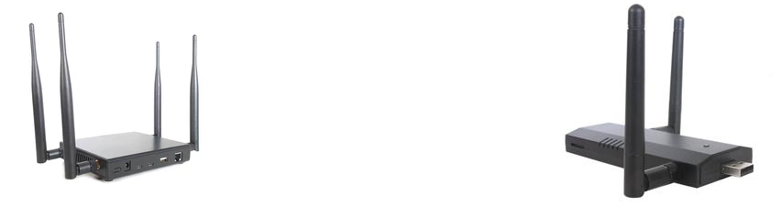
Nano vs. Tetra

Slide 11
Tetra - Hardware
Tetra - Hardware Dual Band 2.4/5 GHz - 533 MHz Network SoC
Four Long Range Antennas - up to 800mW per radio
2 GB NAND Flash
USB Ethernet, USB Serial,USB Host and Ethernet Ports

Slide 12
Nano – Hardware
Single Band 2.4 GHz - 400 MHz Network SoC
Two Standard Antennas - up to 400mW per radio
MicroSD Card Expansion
USB Ethernet Plug, USB Host Port

Slide 13
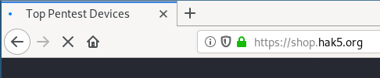
Why Does it Need to Better?
Hak5 is a company who totes having the 'TOP PENTEST DEVICES'

Slide 14
But what makes them the Top Pentest Devices?The claim is that the PineAP is a highly effective rogue access point suite for the WiFi Pineapple. Building on the simple probe request and response nature of Karma, PineAP takes the attack to the extreme.
(Their words, not mine)

Slide 15
KARMA attacks are when an access point pretends to be any access point a device may be looking for.

Slide 16
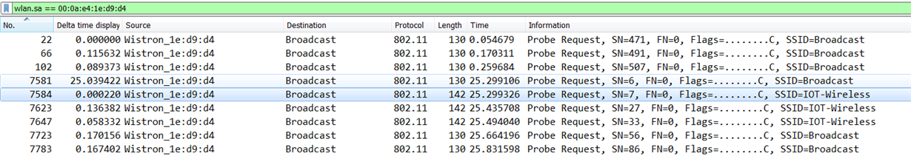

Slide 17
Why does Wireless work this way? Passive scanning is not very efficient.

Slide 18
Instead of waiting on the device to scan through every channel and listen to beacons from the Access Points, why don't we have the client send probe packets of the devices they are looking for.

Slide 19
This allows an attacker to listen for these probe requests and respond as I am < insert > ssid here.

Slide 20
So this is what Hak5 claims they are taking to the extreme, the Karma attack.

Slide 21
Limitations - Hardware *LIMITATIONS ARE IN REFERENCE TO PENTESTING/RED TEAMING. LIMITATIONS MIGHT NOT APPLY TO ALL USE CASES.*

Slide 22
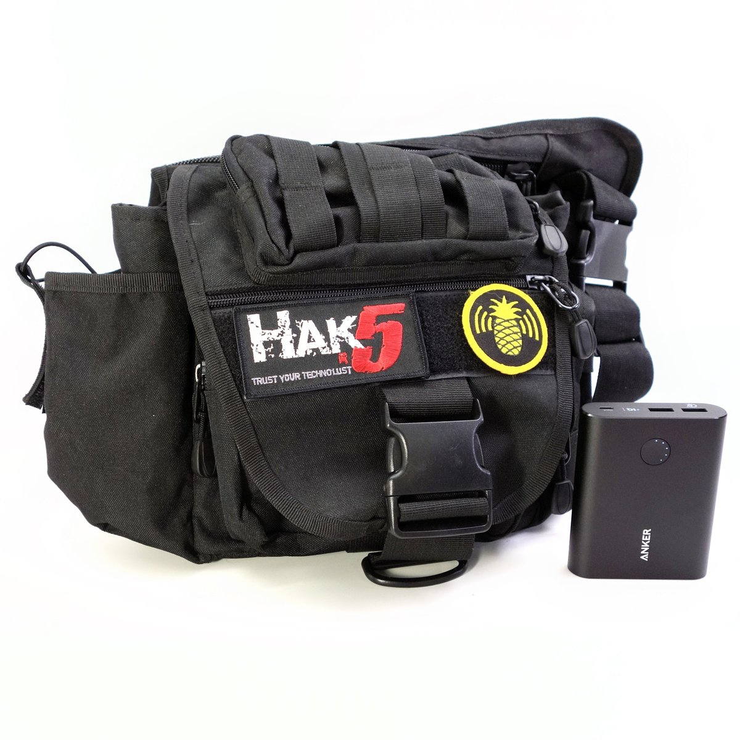
Size

Slide 23

This is what I am trying to avoid looking like.

Slide 24
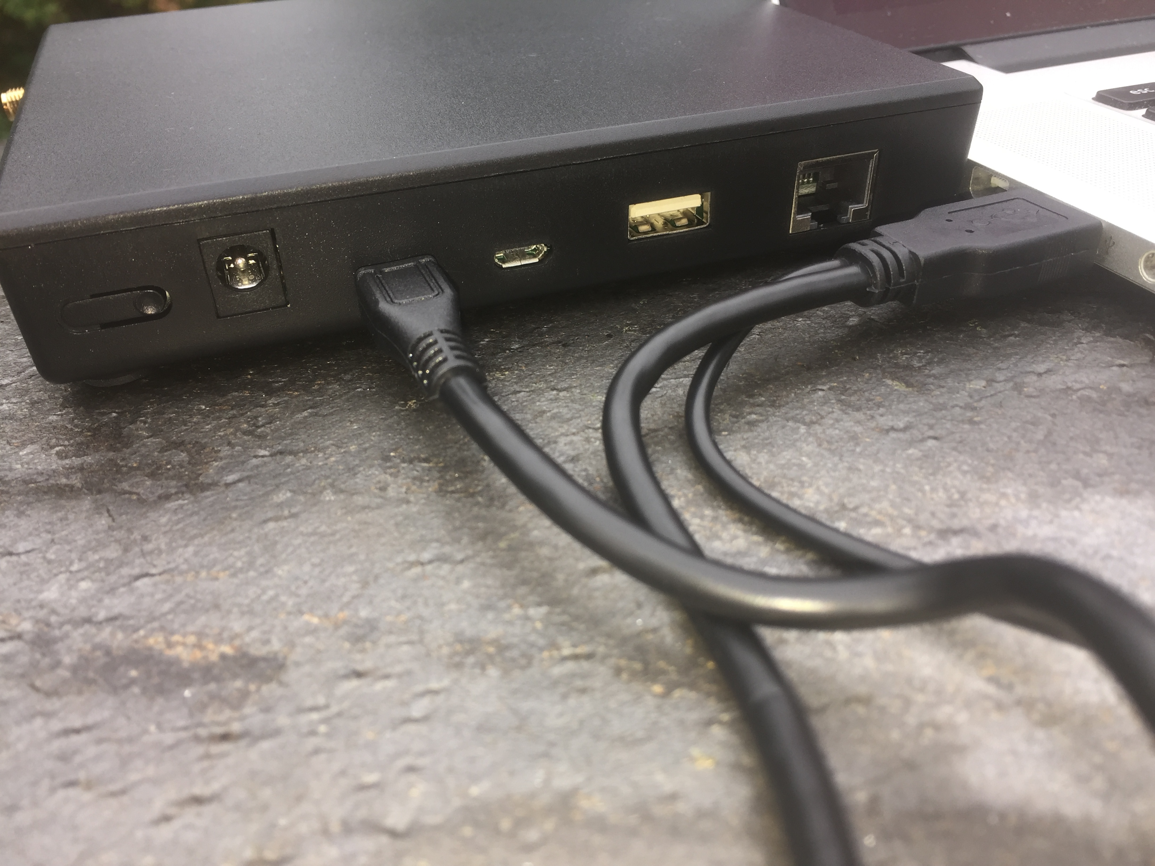
Battery Life/Compatibility

Slide 25


Slide 26


Slide 27
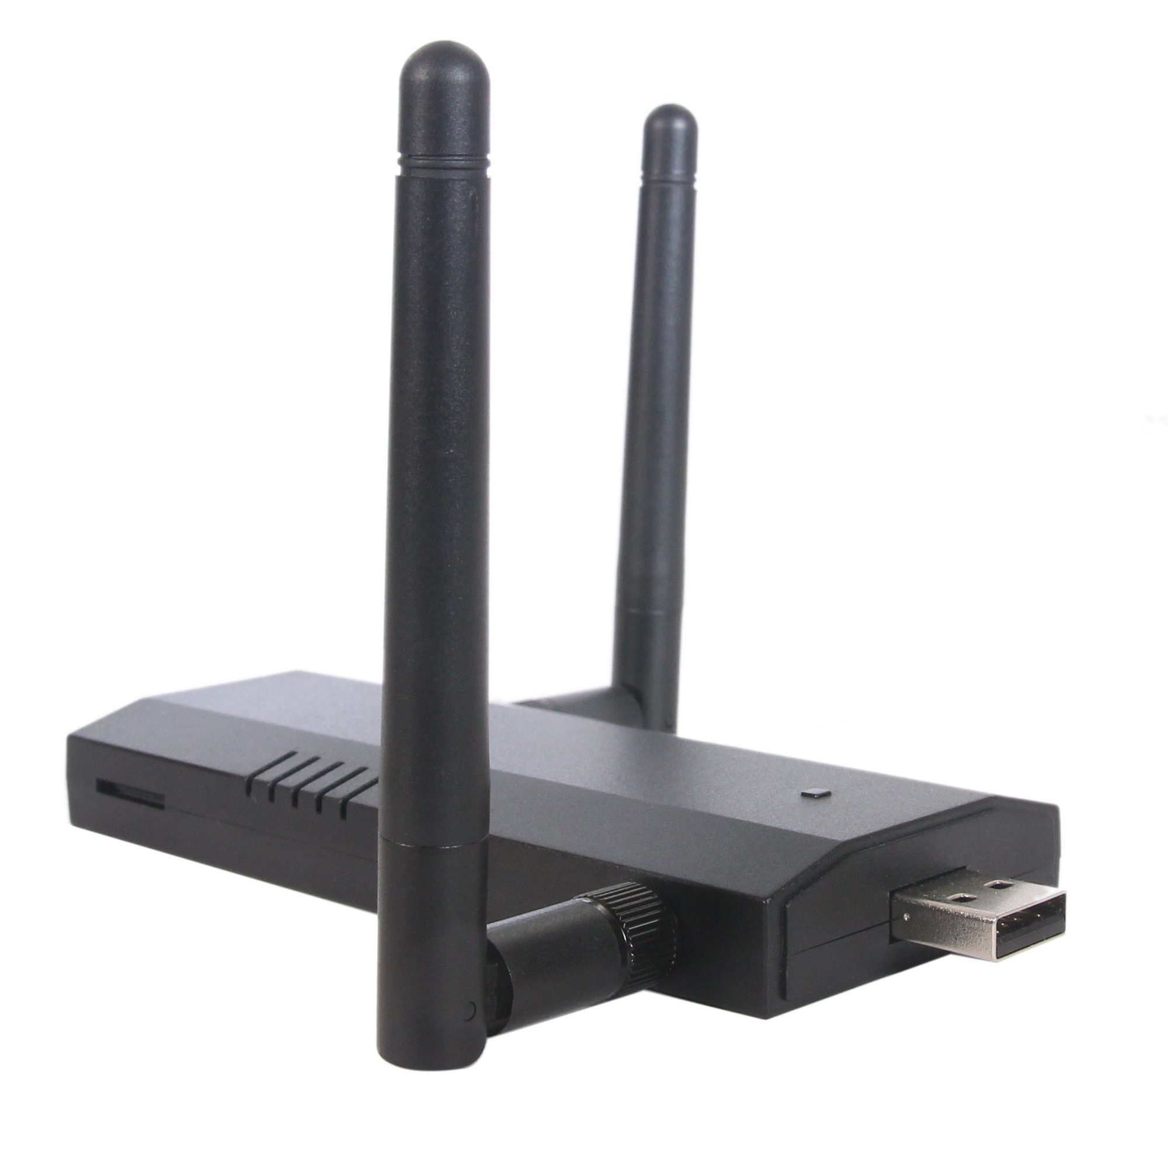

Slide 28
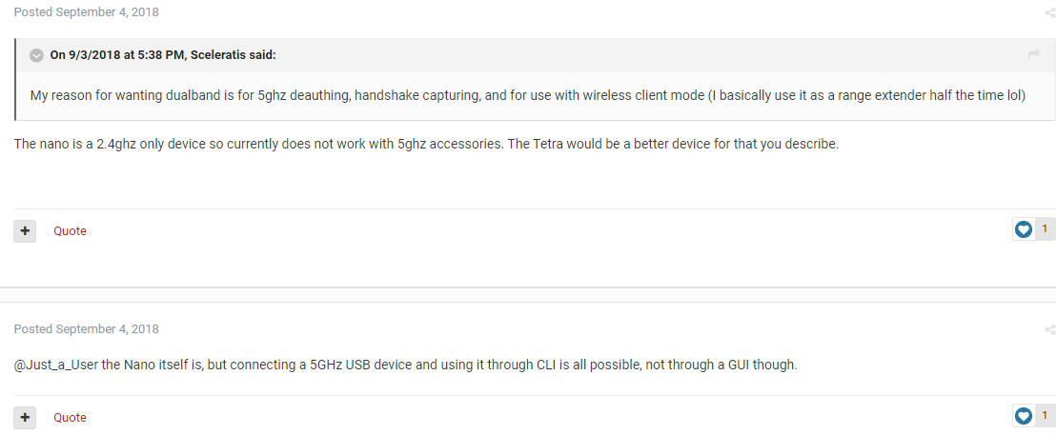

Slide 29
No iOS support. Android only. Thanks Apple. Additionally, only USB support while scanning.

Slide 30
Alternatives

Slide 31
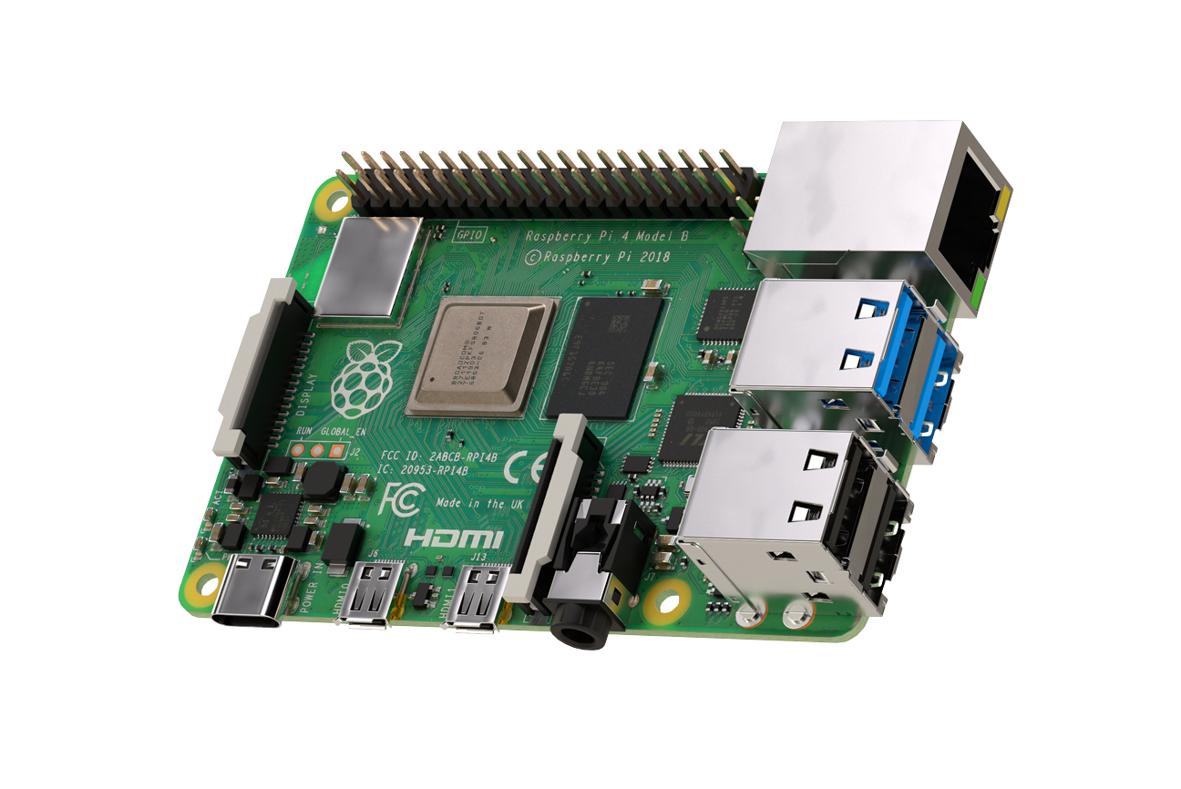

Slide 32
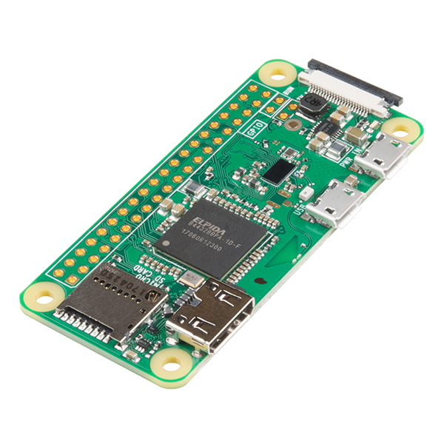

Slide 33


Slide 34
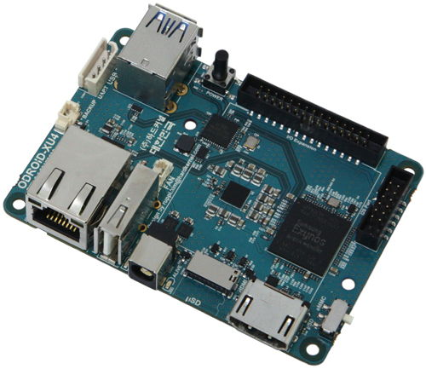

Slide 35
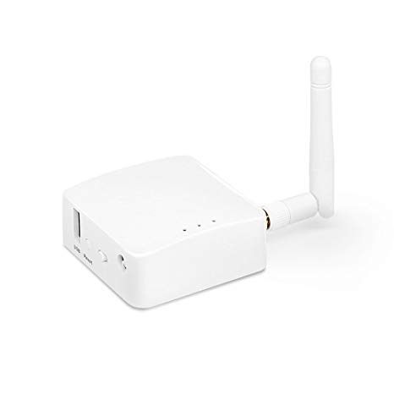

Slide 36
Pineapple – Software
So the Nano and the Tetra have slight differences in the firmware. However, both are based off of OpenWRT.

Slide 37
What all can the Pineapple do?

Slide 38
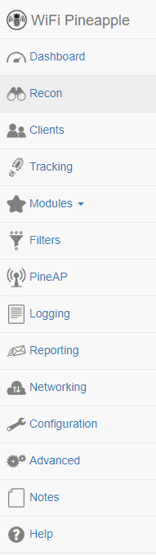

Slide 39
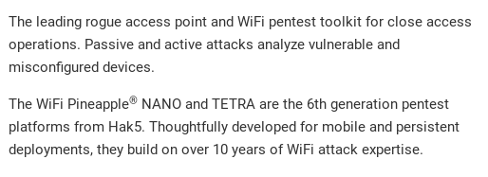

Slide 40


Slide 41
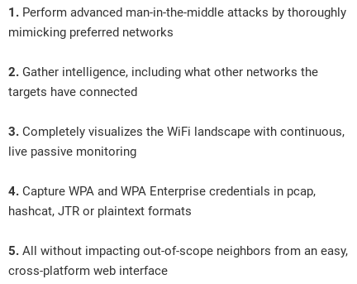

Slide 42
Let's take a little look behind the mask.

Slide 43
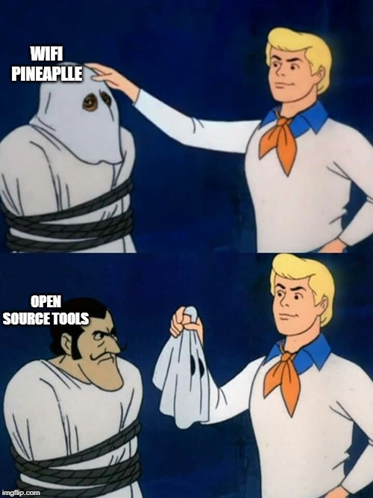

Slide 44
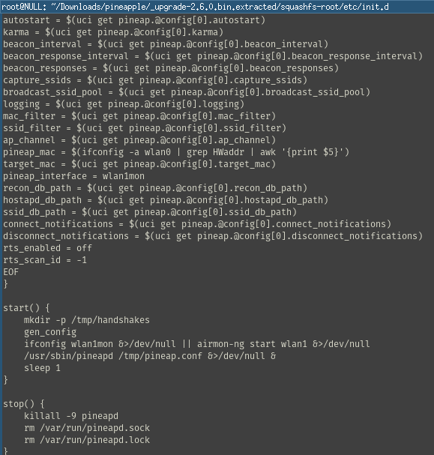

Slide 45
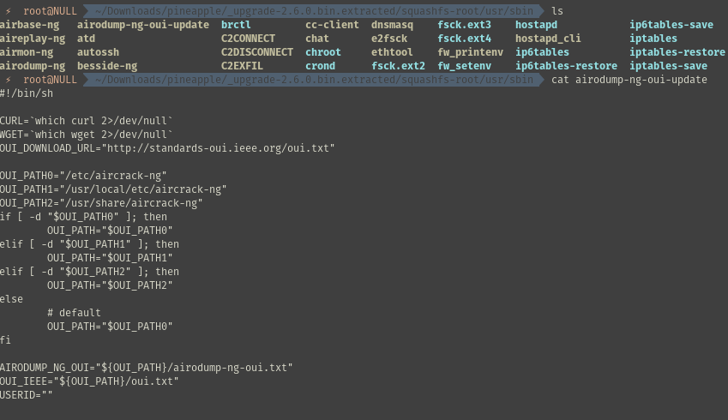

Slide 46
To be clear, I'm not saying AirCrack is a bad tool. I'm saying this doesn't make the WiFi pineapple the best device on the market.

Slide 47
...and then there is the crashes.

Slide 48
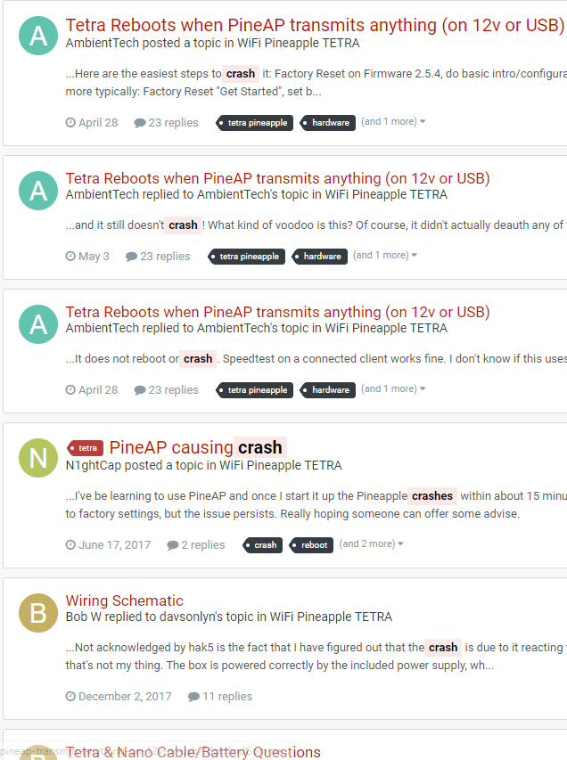

Slide 49
So here is what we need to be able to do...
mitm framework
capture wireless beacons
capture handshakes
not blast the entire wireless space

Slide 50
How Open Source Tools can help

Slide 51

Enter bettercap, the better ettercap

Slide 52
bettercap is the Swiss Army knife for WiFi, Bluetooth Low Energy, wireless HID hijacking and Ethernet networks reconnaissance and MITM attacks.

Slide 53
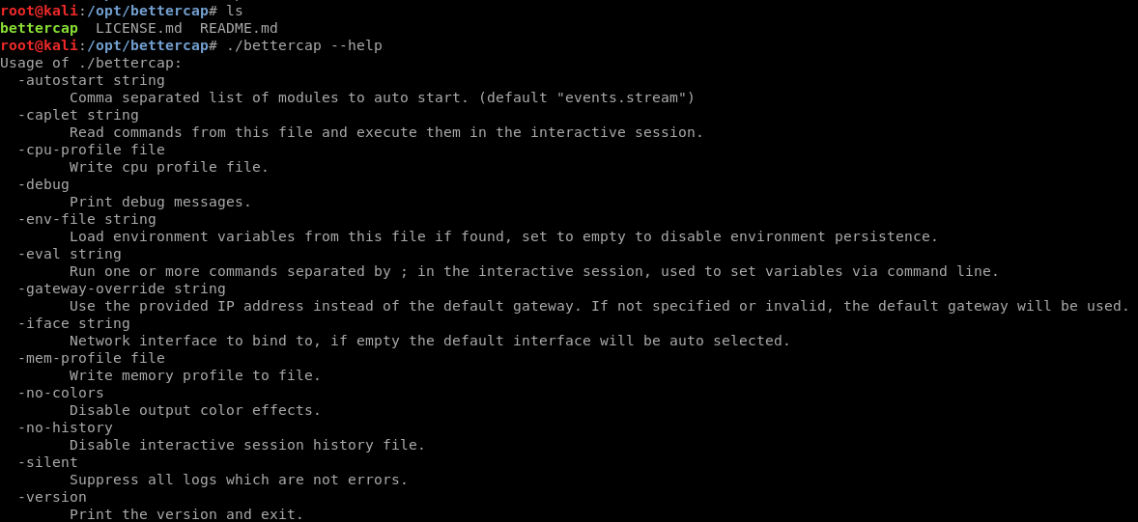

Slide 54
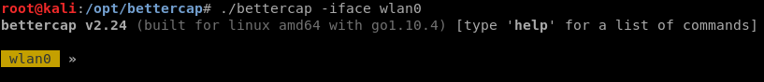

Slide 55
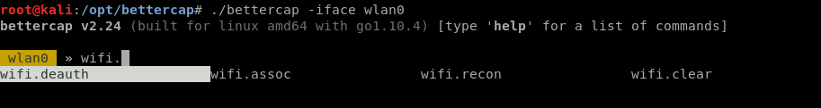

Slide 56
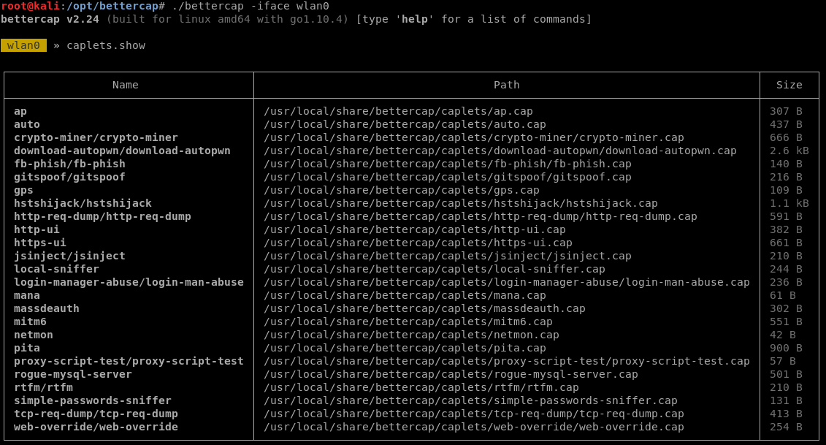

Slide 57
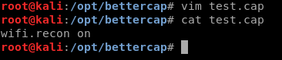

Slide 58
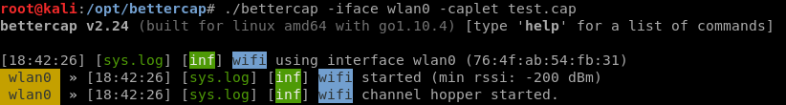

Slide 59
but, but, but, the Pineapple has an easy to use Web UI...

Slide 61
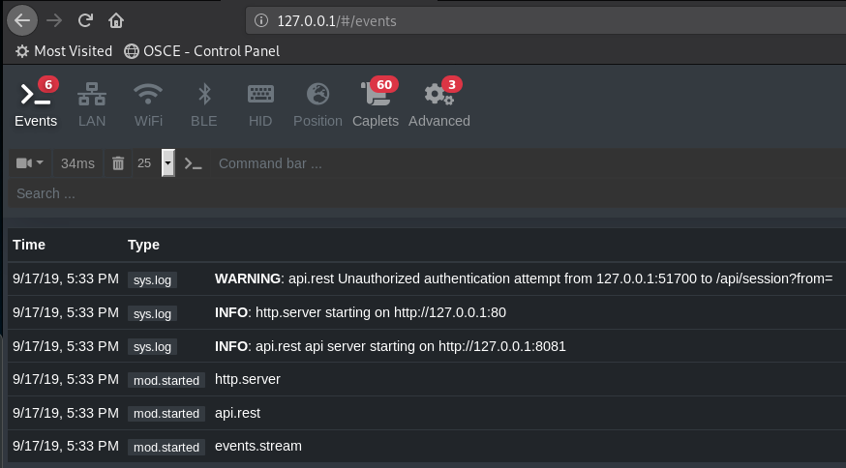

Slide 62
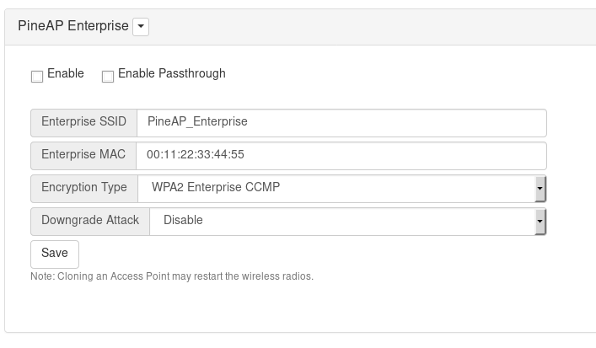
Well what about WPA enterprise attacks?

Slide 64
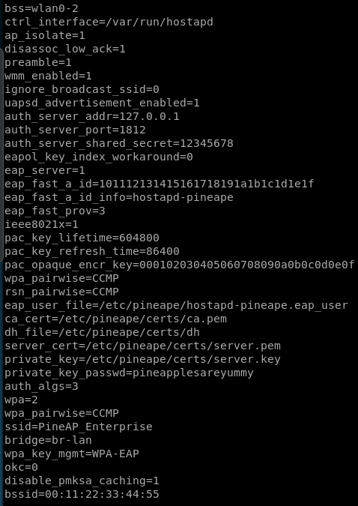

Slide 65
So far this is a bunch of evidence of the Pineapple profiting off of Open Source Software, but what is the PineAP doing?

Slide 66
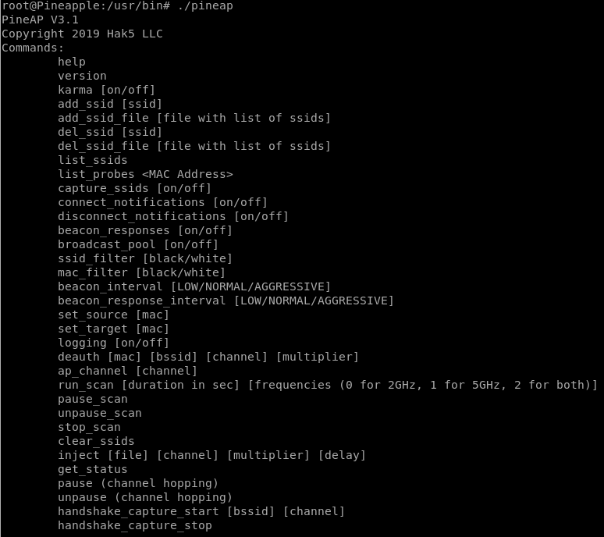

Slide 67


Slide 68
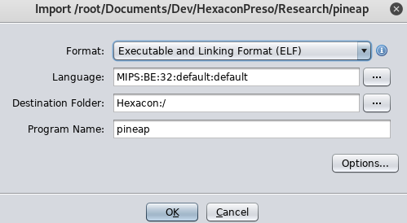

Slide 69
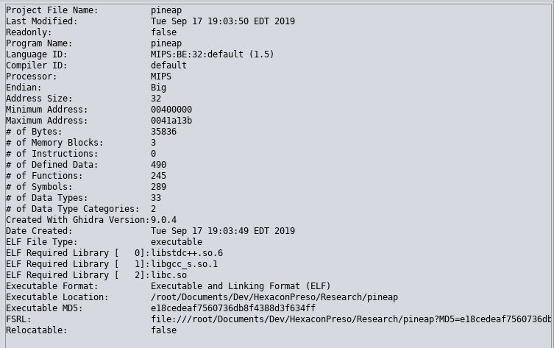

Slide 70
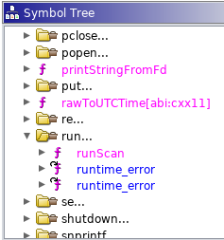

Slide 71
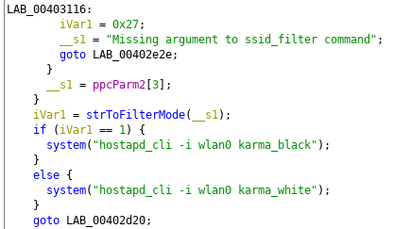

Slide 72
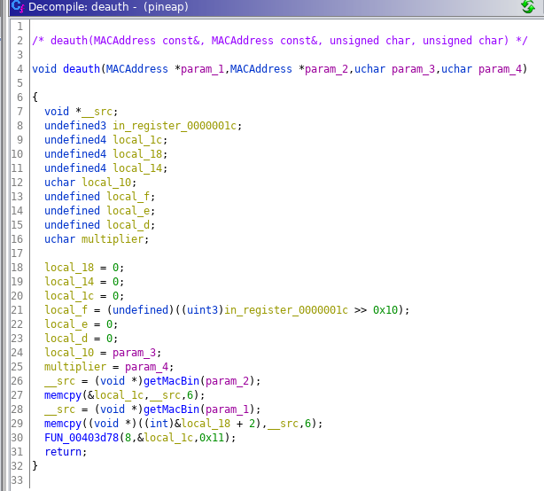

Slide 73
Summary

Slide 74


Slide 75
I'm not quite sure where to go with this information. I would love to build an open source Rasbpian version specifically meant for Wireless testing.

Slide 76
There is a void in the pentesting hardware area right now. Someone else could come in and dominate the wireless hardware offering a superior product for similar price point.

Slide 77
Future Work

Slide 78
Improve upon Open Source Automation.
Find a better singleboard wireless pentesting tool.
Build a better singleboard wireless pentesting tool.
Continue reverse engineering the PineAP.
Future Wireless standards

Slide 79
If anyone wants to help. Hit me up.

Slide 80
Sources and Inspiration: https://hak5.org
Raspberry Pi Org
Bettercap Project
hostapd-wpe
My own pain and suffering

Slide 81


Slide 82
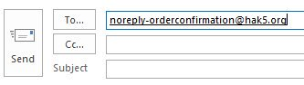

Slide 83


